Slide 1

Credit Risk Modelling
Interpretable Logistic Regression for Consumer Loan Defaults
Retail Lending Analytics | FNB Credit Division | 2026
A.S Gwebityala | S.B Mda | B Teta

Slide 2


Executive Summary Highlights
Model AUC Score
0.795
Key Project Impact
Strategic gains of +0.115 over baseline logistic regression, successfully balancing predictive power with full regulatory interpretability
120 960 loan applications processed
14.5% portfolio default rate managed
Optimal Net Profit threshold identified at 25%
Full compliance with NCR and FCA requirements

Slide 3

Business Context
The Profitability Gap
The baseline model (0.680) resulted in sub-optimal decisioning, leading to missed revenue and elevated credit losses
At an average loan of R10 000, incremental accuracy improvements translate into millions in annual savings
Regulatory Constraints
South Africa lending laws (NCA/NCR) mandate that every credit denial must be explainable in plain language
This prohibits “black-box” ensembles, necessitating a highly engineered but transparent linear model

Slide 4

Project Objectives
Develop a robust, Interpretable pd model that outperforms benchmarks while ensuring absolute transparency
Outperform 0.680 baseline auc
Capture non-linear risk relationships
Optimize p and L decision thresholds
Real-time dashboard deployment

Slide 5
Data Cleaning and Preparation
Data Issue
Informative missingness
Numeric Outliers
Categorical Variance
Dirty Dates
Resolution Strategy
Binary flag creation
Winsorisation at 99th percentile
Unified synonym standardisation and standardised parsing and not coercion
Business Rationale
Missingness is MNAR and highly predictive
Caps extreme leverage without losing power and ensures clean group wise risk assessment
Prevents application timeline errors

Slide 6
Model Methodology
Feature Engineering and Metrics
Primary Risk Driver Analysis:
DTI Ratio
Information value (0.382 – strong). Core Indicator of borrower repayment capacity
Utilisation
Information value (0.348 – strong). Real time stress indicator of revolving credit
Delinquency
Information value (0.317 – strong). Historical behavioral history over 24 months

Slide 7

Feature Engineering Pipeline
Technique
WoE encoding
Interaction terms
Log transformation
L2 regularisation
Features Applied
DTI, utilisation, delinquency
DTI and credit utilisation
Annual Income, loan amount
All model coefficients
Methodology Rationale
Captures non-linear risk step functions
Models multiplicative joint stress risk
Reduces extreme right skew distributions
Prevents overfitting in high-dm space

Slide 8
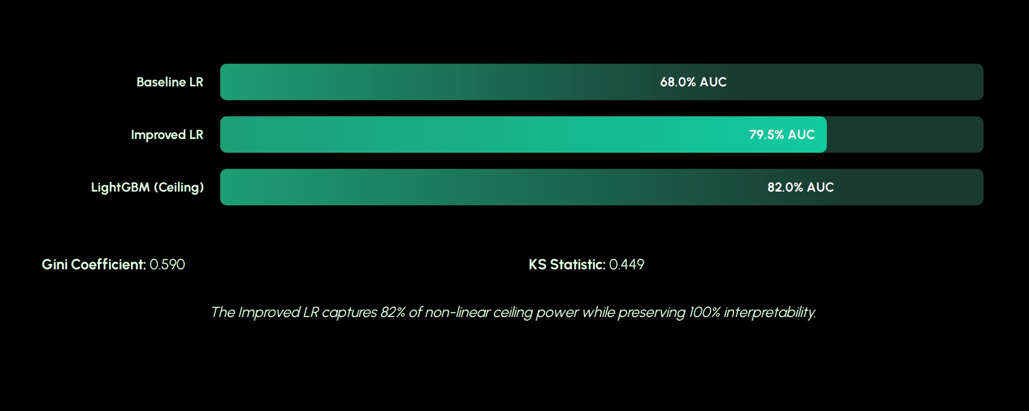
Model Performance Benchmarks

Slide 9
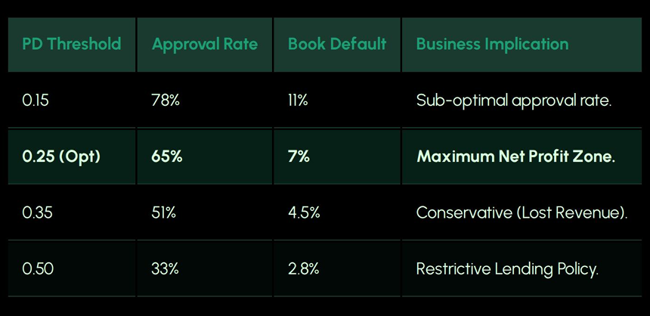
Operational Threshold Analysis

Slide 10
Lending Policy Framework
Auto-approve (<8%)
Prime borrowers with streamlined scoring
Review (18-30%)
Manual intervention and deep-dive audits
Hard Decline (>50%)
High-risk profiles with regulatory notices

